Slide 1

REACT

Slide 2
INTRODUCTION
React is a Library.
Used for designing and developing Frond-End Application.
Create by Facebook
Simple to learn unlike Angular.
It is the “v” of “MVC”.
It use JSX which is similar to HTML

Slide 3
Library vs Framework
Framework will give all tools for development and testing.
Any changes in application should be done with framework.
Purpose:
Frameworks are more comprehensive than libraries. They provide a structured and opinionated foundation for building applications. Frameworks often define the overall architecture, flow, and design patterns of your application.
Library is just a supporting software
Purpose:
Libraries are collections of pre-written code modules or functions that provide specific functionality. They are designed to be reusable components that you can incorporate into your own code to perform specific tasks or operations.

Slide 4
What You will Learn
State= Variable
setState=Change the Variable
Props=pass state to child components.
Lifecycle methods,Example:componentDidMount()
Routing
Hooks

Slide 5
Why shoud you learn react?
You can write reusable codes
Develop mobile apps using React Native
Easy to write and maintain
Faster page switching
It doesn’t refresh

Slide 6
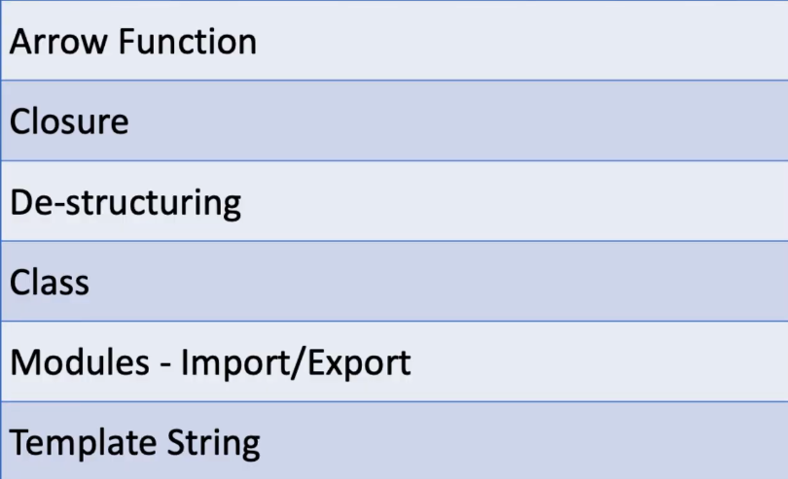
IMPORTANT MODULE FROM ES6

Slide 7
NPM & NPX
NPM (Node Package Manager) and NPX are both command-line tools commonly used in the Node.js ecosystem for managing and executing JavaScript packages and scripts
NPM
npm is a package manager for Node.js, which is a JavaScript runtime that allows developers to run JavaScript on the server-side. npm serves several primary purposes:
Package Installation: npm is used to install and manage packages (also known as modules or libraries) that developers can use in their Node.js projects. These packages can range from simple utility libraries to full-fledged frameworks.
Dependency Management: npm keeps track of dependencies between packages. When you install a package, npm will also install any other packages that it depends on, creating a tree-like structure of dependencies.
Version Control: npm allows developers to specify the version of a package they want to use in their project. This version information is stored in a "package.json" file in the project directory.

Slide 8
NPM & NPX
NPX
npx is a package runner tool that comes bundled with npm starting from version 5.2.0. It is used to execute packages or binaries from the npm registry, especially when you don't want to install them globally or when you want to use a specific version of a package for a single command.
Key features of npx include:
Running Packages: npx allows you to run packages as if they were installed globally without actually installing them. This is particularly useful for running command-line tools that are included in npm packages.
Version Resolution: npx can help resolve package versions if there are multiple versions installed in your project's dependencies, ensuring that the correct version is used.
Package Discovery: If you don't have a package installed globally or locally, npx can help you find and run the most recent version from the npm registry.

Slide 9
CREATE REACT APP
Node.js: React requires Node.js to run. You can download it from the official website: https://nodejs.org/
npm (Node Package Manager): npm comes bundled with Node.js, so you don't need to install it separately.
Step 1: Install create-react-app (if not already installed)
Open your command line or terminal and run the following command to install create- react-app globally: npm i -g create-react-app
Step 2: Create a New React App
Once create-react-app is installed, you can create a new React app by running the following command: npx create-react-app my-react-app
Step 3: Navigate to the App Directory
Change your working directory to the newly created React app:
cd my-react-app
Step 4: Start the Development Server
You can now start the development server, which will serve your React app locally and provide live reloading as you make changes to your code. Run this command:
npm start

Slide 10
BABEL
Babel is an open-source JavaScript compiler or transpiler that is commonly used in web development. Its primary purpose is to transform code written in modern JavaScript (ES6+ or ECMAScript 2015+) into code that can run in older JavaScript environments or browsers that may not support the latest language features. Babel allows developers to write code using the latest JavaScript syntax and features while ensuring compatibility with a wide range of browsers and environments.
Some key features and use cases of Babel include:
Presets: Babel offers presets, which are pre-configured sets of plugins that cater to specific use cases. Popular presets include "env" for targeting specific environments, "react" for React.js applications, and others.
Integration: Babel can be integrated into various build tools and development workflows. It's commonly used with bundlers like Webpack and task runners like Gulp to automate the transpilation process.
Support for JSX: Babel is often used in combination with React.js, as it can transpile JSX syntax into JavaScript that browsers can understand.

Slide 11
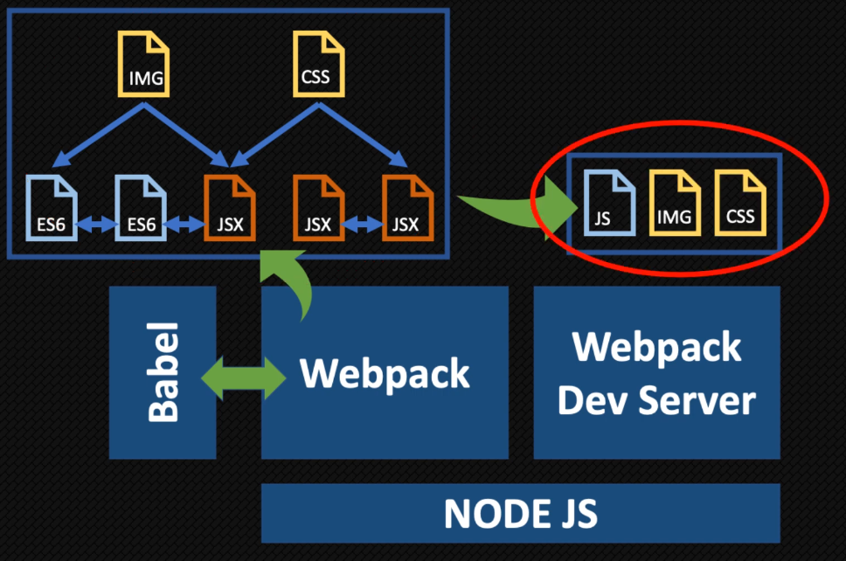
WEB PACK & WEB PACK SERVER
WEBPACK
Webpack is a powerful open-source JavaScript module bundler. It takes all your project's assets, such as JavaScript files, CSS, images, and more, and bundles them into optimized bundles or assets that are ready to be served to the browser

Slide 12
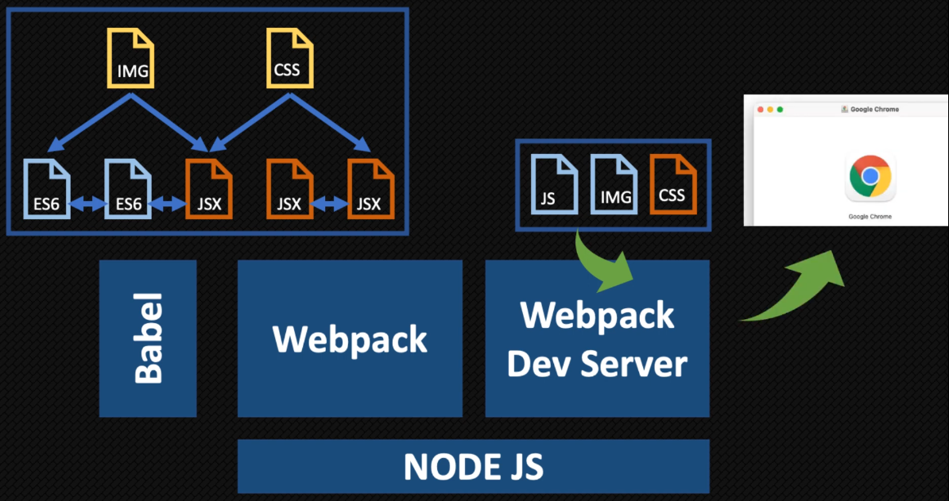
WEB PACK & WEB PACK SERVER
WEBPACK SERVER
Webpack Dev Server is a development server that works seamlessly with Webpack. It provides an efficient way to develop your React.js applications by serving your application's assets during development and enabling features like hot module replacement.

Slide 13
JSX
JSX stands for JavaScript XML.
JSX allows us to write HTML in React.
JSX makes it easier to write and add HTML in React.
Example
const myElement = <h1>I Love JSX!</h1>;
const root =ReactDOM.createRoot(document.getElementById('root')); root.render(myElement);

Slide 14
CLASS ATRIBUTE
Class in HTML
<div class=“my data”>hello team</div>
How to create clss in attribute in JSX
<div className=“my data”>hello team</div>

Slide 15
INLINE CSS
import ReactDOM from 'react-dom/client';
import './index.css';
const custom={
backgroundColor:"green",
fontSize:"70px",
borderRadius:"20px",
color:"white"
}
const root = ReactDOM.createRoot(document.getElementById('root'));
root.render(
<div style={custom}> hai</div>
);

Slide 16
REACT COMPONENTS
In React, components are the building blocks of a user interface. They are reusable, self-contained pieces of code that can be composed together to create complex UIs. There are two main types of components in React:
Function Components:
Function components are defined using JavaScript functions.
They are also known as stateless or functional components.
Function components are used when the component doesn't need to manage its own state (prior to React 16.8) or when you want to use hooks to manage state (React 16.8 and later).
Class Components:
Class components are defined using JavaScript ES6 classes.
They are also known as stateful components because they can manage their own state using this.state.
Class components are used when you need to manage state or access component lifecycle methods.

Slide 17
WHY TWO TYPES OF COMPONENT?
State-manage the data inside the component
LifeCyclemanagement-
Hooks-Functional component
classComponent

Slide 18
Adding CSS in REACT

Slide 19
Props in REACT JS
In React, "props" (short for "properties") are a fundamental concept used for passing data from a parent component to a child component. Props are a way to make your components dynamic and reusable by allowing you to customize their behavior and appearance based on the data you pass to them.
Destructuring props in ReactJS
In React.js, you can destructure props (short for properties) in functional components to easily access and use the values passed down to your component. Destructuring makes your code more concise and readable. Here's how you can destructure props in a React
Syntax:
function MyComponent(props) {
// You can destructure props like this:
const { prop1, prop2, prop3 } = props;
return (
<div>
<p>{prop1}</p>
<p>{prop2}</p>
<p>{prop3}</p>
</div>
);
}

Slide 20
Props in REACT JS
Pros with No value
“If we are not giving value into property it will be by default taken true”
<Label isActive>

Slide 21
React Life Cycle

Slide 22


